Slide 1
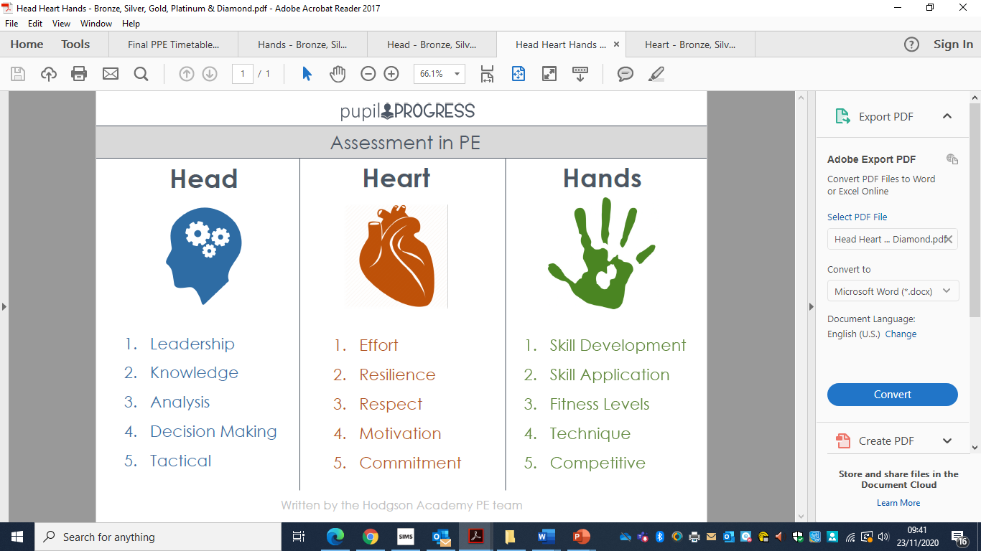
The Piggott School KS3 Assessment in PE
Knowledge & Understanding
Tactical Awareness
Decision Making
Leadership
Analysis
Feedback & Evaluate
Respect
Effort
Confidence
Resilience & Courage
Motivation/Dedication
Commitment
Skill Development & Application
Fitness Levels
Technique
Teamwork
Competitiveness
Lead healthy, active lives
The Piggott School Model

Slide 2
KS3 Head, Heart & Hands Scheme of Work
Time of Year | Head | Heart | Hands
Sept – Oct H/T | Knowledge & Understanding | Respect | Skill Development & Application
Oct H/T – Christmas | Tactical Awareness | Effort | Fitness Levels
Christmas – Feb H/T | Decision Making | Confidence | Technique
Feb H/T – Easter | Leadership | Resilience & Courage | Teamwork
Easter – May H/T | Analysis | Motivation/Dedication | Competitiveness
May H/T – Summer | Feedback & Evaluate | Commitment | Lead healthy, active lives

Slide 3
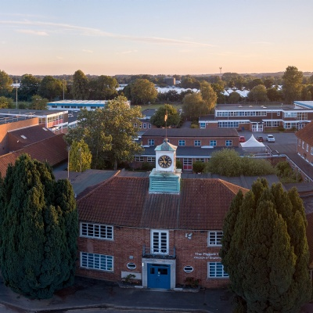
HEAD: Knowledge & Understanding, Tactical Awareness, Decision Making, Leadership, Analysis and Feedback & Evaluate
LEVEL | DESCRIPTION
BRONZE | Knowledge & Understanding: I am starting to gather knowledge and understanding from the sports I am participating in. My knowledge of each sports is inconsistent. Tactical Awareness: I am starting to develop my tactical awareness in very small aspects of the sports participated in. I am at the very early stages of identifying tactical problems that arise during a game and therefore am not responding appropriately. Decision Making: I understand why decision making is important during sport and physical activity. I do not always make the correct decisions when faced with competitive, challenging situations. I am developing my learning and practicing making decisions in action, in response to different situations. Leadership: I understand the importance of leadership and how it can improve team performance. I take more of a back seat when put in game situations let others lead & make decisions. Analysis & Feedback: I recognise the importance of analysis & feedback can have on self & peer performance. I am able to analyse skills & performance & give feedback to peers, however, this lacks detail and is blunt. I struggle to give informative feedback to peers and myself about performance or skills. Evaluate: I am able to evaluate my own performance, however, it lacks depth and detail. I struggle to evaluate others & use the correct terminology to evaluate own and others performance.
SILVER | Knowledge & Understanding: I am gathering more knowledge and understanding from the sports I am participating in. My knowledge of each sports is inconsistent, but I am very keen to learn and gain a better knowledge & understanding. Tactical Awareness: I am gradually improving my tactical awareness in more aspects of a variety of sports participated in. Decision Making: I understand why decision making is important during sport and physical activity. I do not always make the correct decisions when faced with competitive, challenging situations. I am developing my learning and practicing making decisions in action, in response to different situations. Leadership: I am starting to develop my leadership skills in small groups. Organising others when asked to complete a drill is where my leadership ability is currently at. When put into a game situation, I take a back seat and let others lead. Analysis & Feedback: I recognise the importance of analysis & feedback can have on self & peer performance. I am able to analyise skills & performance & give feedback to peers, however, this lacks detail and is blunt. I struggle to give informative feedback to peers and myself about performance or skills. Evaluate: My ability to evaluate my own performance is improving, however, I am using simple terminology doing so. I struggle to evaluate others & use the correct terminology to evaluate own and others performance. I can occasionally identify some strengths and areas of development.
GOLD | Knowledge & Understanding: I am gathering lots of knowledge and understanding from the sports I am participating in. I then can apply this knowledge & understanding in competitive game situations to improve mine own & team performance. Tactical Awareness: I am gradually improving my tactical awareness in more aspects of a variety of sports participated in. I can identify tactical problems that arise during a game and sometimes respond appropriately. Decision- Making: I make accurate decisions in most sports when performing skills in isolation or when put in a competitive & challenging environment. I am able to respond to different situations in most sports participated in. Leadership: I am becoming more confident it my leadership. I understand some of the leadership styles and trying to implement them into group work. When put in game situations I am confident enough to give my opinion but not necessarily the key leader in the team. Analysis & Feedback: I am able to analyse my own performance and give intrinsic feedback on what went well & what areas I need to improve on. The detail & length of feedback I give to others is improving. I occasional giving feedback to others without being asked to. Evaluate: My ability to evaluate my own & others performances is good. I am using sound terminology whilst evaluating. I can often identify some strengths and areas of development from both my own and peers' performances.

Slide 4
HEAD: Knowledge & Understanding, Tactical Awareness, Decision Making, Leadership, Analysis and Feedback & Evaluate
LEVEL | DESCRIPTION
PLATINUM | Knowledge & Understanding: I have gathered lots of knowledge and understanding from the sports I am participating in and am confident in explaining elements of the sports to peers and teachers. Tactical Awareness: Tactical awareness is a strength of mine in most sports participated in. I can clearly identify tactical problems that arise during a game and respond appropriately with control. Decision-Making: I consistently make justified decisions when performing skills in isolation or when put in a competitive & challenging environment. I am able to make quick decisions in many different situations. Leadership: I am confident in my ability to lead. I lead others with purpose & passion and understand the effect effective leadership has on the team. I am able to lead others in isolated skill drills & through competitive, high pressured, game situations. Analysis & Feedback: I can comfortably analyse my own performance and give intrinsic feedback on what went well & what areas I need to improve on. I am also able to take extrinsic feedback from others & use this to improve my own performance. The detail & length of feedback I give to others is excellent. I am consistently giving feedback to others without being asked to. I can also analyse my own & others performances & use it to develop my own performance. Evaluate: My ability to evaluate my own & others performances is excellent. I am using advanced terminology whilst evaluating. I am regularly identifying strengths and areas of development from both my own and peers' performances.
DIAMOND | Knowledge & Understanding: I have demonstrated my knowledge and understanding through practical sports I am participating in and am very confident in explaining elements of the sports to peers and teachers. This is across all sports on the curriculum. Tactical Awareness: Tactical awareness is a great strength of mine in all sports participated in. I can clearly identify tactical problems that arise during a game and always respond appropriately with control & precision. Decision Making: I am able to make complexed and precise decisions quickly and effectively when faced with competitive & challenging situations. I also make excellent decisions when performing isolated skills. I am constantly practicing making decisions in action, in response to a variety of different situations. Leadership: I am consistently one of the most predominate leaders within the class, throughout all sports on the curriculum. I understand how to apply leadership styles into practical situations and scenarios. I can consistently lead my team to high quality performances which usually result in victory. Analysis & Feedback: I can analyse my own & others performances with quality and effectiveness. I am able to take extrinsic feedback on board and transfer this into improvements in my performance. The detail & length of feedback I give to others is outstanding. I am constantly giving feedback to others without being asked to. I can also analyse my own & others performances & use it to develop mine & my peers performances. Evaluate: My ability to evaluate my own & others performances is exceptional. I am using complex terminology whilst evaluating. I am consistently identifying strengths and areas of development from both my own and peers' performances.

Slide 5
HEART: Respect, Effort, Confidence, Resilience & Courage, Motivation/Dedication, Commitment
LEVEL | DESCRIPTION
BRONZE | Respect: I show awareness and understand the impact respect has on sport & physical activity Effort: I understand the more effort I put in the better my performance will be. I also understand I need to increase my effort levels in order to reach the next level Confidence: I am confident in my cognitive, emotional & physical ability in 1-2 sports within the curriculum Resilience & Courage: I try my best not to give up on challenging situations but sometimes this is difficult for me. My attitude and performance is effected. Motivation/Dedication: I show motivation & dedication in activities I like, however understand I need to show these traits in all sports participated in Commitment: I show commitment in sports I enjoy and interest in co-curricular activities within that sport. Participation and kit record has room for improvement.
SILVER | Respect: I am developing being respectful to my peers in competitive sporting situations. I am always respectful of equipment and members of staff. Effort: I am starting to put 100% effort into my favourite sports. I understand I need to try and put this effort into every sport I participate in. Confidence: I am confident in my cognitive, emotional & physical ability in 3-4 sports within the curriculum Resilience & Courage: I am starting to show signs of resilience & courage when faced with difficult or challenging situations. I am able to take failure more positively. Motivation/Dedication: I show motivation & dedication across a number of different sports and activities. I am motivated to succeed and develop my overall ability. Commitment: I show commitment and interest in a variety of sports & co-curricular. Participation and kit is improving but still can be better.
GOLD | Respect: I am always respect to my peers and members of staff. I am beginning to understand how to be respectful in a competitive sporting environment and show this through sportsmanship. Effort: I show good levels of effort and am always wiling to participate in all sports on the curriculum. I have good work ethic and determination, in most sports. Confidence: I am confident in my cognitive, emotional & physical ability in 5-6 sports within the curriculum. Resilience & Courage: I am working hard to show resilience & courage throughout all lessons within the curriculum. I take feedback positively from my peers and teachers. Motivation/Dedication: I am motivated to succeed in most activities. I am dedicated and willing to give all sports a go. Commitment: I show commitment in most sports participated in. I am very interested in co-curricular. Participation and kit is consistently good.

Slide 6
HEART: Respect, Effort, Confidence, Resilience & Courage, Motivation/Dedication, Commitment
LEVEL | DESCRIPTION
PLATINUM | Respect: I always show respect & empathy towards my peers and members of staff. I also encourage others to participate and compete in all sports on the curriculum. I support teacher and am helpful with lesson organisation. Effort: I strive to apply maximum effort in all activities. I am very determination to succeed & am empathetic towards peers where I provide support and encouragement. Confidence: I am confident in my cognitive, emotional & physical ability in all sports within the curriculum. I am now beginning to develop confidence in leading others within the class and being a role model for less able students. Resilience & Courage: I understand success takes hard work & show traits of this within sports across the curriculum. I am able to take setbacks and feedback with maturity & implement this further. Motivation/Dedication: I show high levels of motivation & dedication in a wide range of activities. I am dedicated to all sports on the curriculum and show high levels of enthusiasm, even for sports I do not particularly like. Commitment: I enjoy representing the school in co-curricular activities and fixtures. Very high levels of participation and kit is always good.
DIAMOND | Respect: I always support the teachers. I constantly demonstrate respect and embrace diversity, encouraging others to participate Effort: I give maximum effort to all lessons and act as a role model. I am always determine to succeed & have high level of empathy towards my peers and teachers. I am also able to provide support and encouragement throughout all sports on the curriculum. Confidence: : I am confident in my cognitive, emotional & physical ability in all sports within the curriculum. I am now confidence in leading others within the class and being a role model for less able students. Resilience & Courage: I understand to be successful takes hard work. I am able demonstrate my resilience and courage every lesson through difficult challenging situations and scenarios put in. I am able to take setbacks and failure maturely, using experiences and feedback to better myself in the future. Motivation/Dedication: I show extremely high levels of motivation & dedication in wide range of activities. I am extremely hard working and dedicated to all sports on the curriculum and show high levels of enthusiasm in all sports participated in. I even try and motivate others who might be struggling. Commitment: I am proud to represent school in co-curricular. I am always committed to do my very best. Exemplary participation and kit

Slide 7
HANDS: Skill Development & Application, Fitness Level, Technique, Teamwork, Competitiveness and Lead Healthy, Active Lives
LEVEL | DESCRIPTION
BRONZE | Skill Development & Application: I show an understanding of how skills and activity should be performed. I am able to perform skills in isolation but struggle to maintain technique in drills and challenging competitive situations. Fitness Levels: I understand why fitness levels are important to improve performance, however I sometime find it difficult to perform at my best for the entirety of the lesson. This often results in flaws in my performance. Technique: My technique when performing basic skills in isolation is good. It starts to deteriorate when put into a competitive game situation. Teamwork: I enjoy working in small teams and with peers. I am not leading my team just yet but understand the importance of teamwork and how it will improve collective performance. Competitiveness: I show some levels of competitiveness in the sports I enjoy participating in. Sports I do not particularly like, I struggle to be competitive in & rather participate in isolated skills. Lead Healthy, Active Lives: I understand that being healthy and active is important in life. I am only active in PE lessons, I am not very active outside of PE lessons.
SILVER | Skill Development & Application: I can demonstrate some skills with elements of appropriate technique, but inconsistent. I am starting to show some precision of these skills in progressively challenging situations and apply basic and simple skills. I am a little inconsistent in advanced competitive situations. Fitness Levels: My fitness levels are developing and are now at a satisfactory level for short periods of time. I find it difficult to perform consistently for long periods of time but am really starting to see improvements Technique: I am now starting to show good technique in spells of isolated drills and activities. My technique decreases when faced with higher pressured competitive situations, however it is emerging and showing improvement. Teamwork: I am able to work well in teams of different sizes. I understand that I need to my team mates to be successful in team sports. Occasionally, I am a little selfish and still try to do things on my own. Competitiveness: I am capable of showing competitiveness in a range of different sports, however, this can be inconsistent at times. I enjoy competitive sport and representing the school when called upon. Lead Healthy, Active Lives: I lead a active life, walking to school & being active at break/lunch times. Away from school life I may attend 1 club a week.
GOLD | Skill Development & Application: I have a good level of skill application in isolated and progressive drills. Occasionally I am able to adapt in challenging competitive situations. I am able to apply a range of most advanced skills. My technique is maintained during most drills & competitive situations. My skills are mostly applied with fluency & control Fitness Levels: I have a good level of fitness and confident I can get through PE lessons, clubs & fixtures without much fatigue. Occasionally, this may deteriorate in fast pace game play and against other talented sports people. Technique: I mostly demonstrate good technique in competitive activities over a range of both individual and team sports. I am confident in my own technical ability and able to showcase this within PE lessons, clubs & fixtures. Teamwork: I understand that teamwork is critical for success and am able to apply this within partner work, group drills and team games. I am a valued member of my team who is respected by my fellow peers. Competitive: I enjoy competitive drills and games in both individual & team sports. I thrive for competition and like to win. However, I need to work on my attitude when losing. This can sometimes let me down. Lead Healthy, Active Lives: I understand why sport is important physically, mentally and socially for my health and wellbeing. I lead a healthy active life where I exercise outside of the curriculum because I want to. I attend clubs in a variety of different sports across the year.

Slide 8
HANDS: Skill Development & Application, Fitness Level, Technique, Teamwork, Competitiveness and Lead Healthy, Active Lives
LEVEL | DESCRIPTION
PLATINUM | Skill Development & Application: I have a excellent level of skills application in isolated and progressive drills. I only make minor errors and am able to adapt when faced with progressively challenging situations. I successfully apply a range of advanced skills. My technique is maintained in many activities when faced with advanced competitive situations. My skills are almost always applied with fluency, control and confidence. Fitness Levels: I have a high level of fitness. I am able to complete PE lessons, clubs & fixtures comfortably without fatigue. I very rarely tier when competing. Technique: I demonstrate excellent technique in skills and competitive situations in a wide range of sports across the curriculum. I am very confident in my own technical ability & can show this consistently in PE lessons, clubs & fixtures. Teamwork: When working in teams, I am an instrumental member that others look up to as a role model. I include my whole team and make sure everyone has a say in tactics & strategies. I do not leave any member out at any time. Competitive: I am naturally competitive and thrive under pressure. I always want to succeed and enjoy winning, however, I am gracious in defeat. Lead Healthy, Active Lives: : I understand why sport is important physically, mentally and socially for my health and wellbeing. I lead a very healthy active life where I exercise outside of the curriculum because I want to. I attend many clubs, represent the school in fixtures and have an overall active lifestyle.
DIAMOND | Skill Development & Application: I have an outstanding level of skill application and consistently demonstrate advanced skills in isolated and progressive drills. I rarely make errors in a variety of sports and am very capable of adapting to competitive and challenging situations when competing in games/matches. Fitness Levels: I have outstanding levels of fitness. I am able to complete PE lessons, clubs & fixtures with ease without any signs of fatigue. successfully apply complex skills. Technique maintained in advanced competitive situations. Skills consistently performed with fluency, control and confidence. Technique: I consistently demonstrate advanced technique in the majority of skills & drills participated in. I am extremely confident in my own technical ability & always showcase these in PE lessons, clubs, fixtures & sports played outside of school. Teamwork: When working in teams, I am an instrumental member that others look up to as a role model. I take it upon myself to uptake a leadership role within the team. I am able to delegate positions and organise others to maximum performance. Competitive: I am naturally competitive and thrive under pressure in all sporting situations. I always want to succeed and love to win. I am very gracious in defeat and failure drives me to develop my ability, skills and performance further in the future. Lead Healthy, Active Lives: I understand why sport is important physically, mentally and socially for my health and wellbeing. I lead an extremely active life where I exercise outside of the curriculum because I want to. I attend the majority of clubs, represent the school in many teams on offer and have an overall active lifestyle.

