Slide 1


Year 10
Welcome Evening
Thank you for joining us
Notes:
EJW

Slide 2
Year 10 Pastoral Team
Tutor Team
Miss J Brookes
Miss K Mercer
Mr A Pearce
Miss M Burns
Senior Leadership
Links for KS4
Mr D Thatcher
Ms K Thornton
Mrs E Winter
Head of Key Stage 4
Mrs V Knopp
Head of Year 10
Mrs M Tomo
Assistant Head of Year 10
Mr M Smith
Miss S Taylor
Mr M Fitzmaurice
Mrs S Floyd/
Mrs N Jordan-Lewis
Mr J Piper
Pastoral Support
Mrs M Coles
Pastoral Support Admin
Mrs L Kilby
Green Room Manager
Notes:
EJW

Slide 3
Progress Reports
Friday 15th November | Autumn Term Progress reports issued
Friday 7th February | Spring term Progress reports issues
Thursday 13th March | Year 10 Parents Evening
Friday 6th June | Summer term Progress reports issued
Notes:
VK

Slide 4

GCSE Grading System
Standard Pass
Notes:
EJW

Slide 5
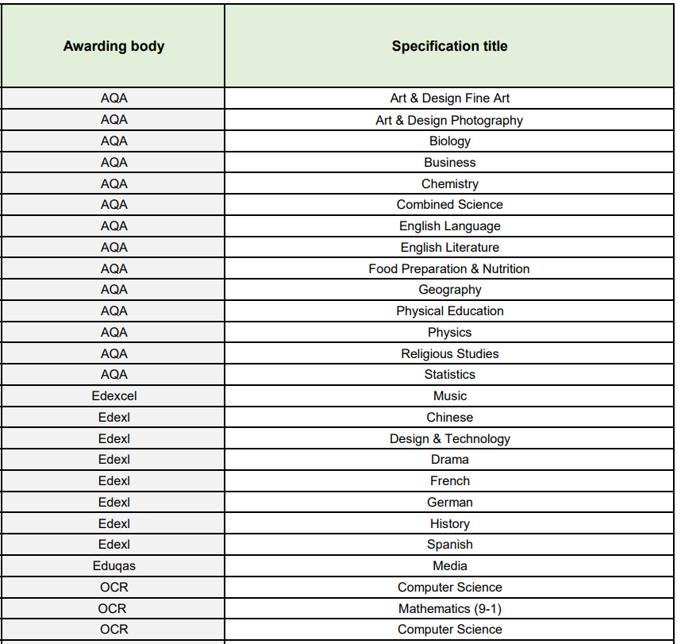
GCSE Exam Boards
Exam Information Link
Notes:
EJW

Slide 6
GCSE Assessment
RE PPE (Pre-public examination) 6/12/24
RE GCSE May/June 2025
Coursework
Practical Exams – e.g. drama and food tech
Year 11 PPEs November 2025
Final theory examinations May/June 2026
Notes:
Food prac exam in y10 – April, drama exam y10 May
VK

Slide 7
Religious Studies
Head of Department
Mr T Stone
Notes:
VK

Slide 8
Religious Studies
Each paper is 1h45
PPE March
Paper 2: Thematic Studies
Theme A: Marriage & Relationships
Theme B: Religion & Life
Theme D: Religion, Peace & Conflict
Theme E: Religion, Crime & Punishment
Paper 1: Study of Religions
Christianity Beliefs
Christianity Practices
Islam Beliefs
Islam Practices
PPE 6th December
Notes:
VK

Slide 9
Religious Studies
5 Hours of RE timetabled lessons a fortnight (10Q1 & 10P1 get 4)
Revision sessions run by class teachers – tailored to each class (speak to class teacher for more info)
Revision Guide handed out to all Year 10 pupils to use at home
Flashcards and Mindmaps issued via SMHW
Other resources handed out if needed – folders, plastic wallets, dividers, stationery, etc…
Lesson-by-lesson Teaching plan given to every student
Week-by-week revision plan with revision topics to focus on at home and in after school sessions
Notes:
VK

Slide 10
Core Subjects
English
Mathematics
Science
Notes:
VK

Slide 11
English
Support at Home:
Online
BBC Bitesize, Litcharts, Mr Smith’s YouTube channel!
In print
CGP Revision Guides – available for both language and literature
York Notes for GCSE
It is vital that students begin to learn key quotations for the texts from the very start of year 10
5 key quotations for each main character (from across the whole plot) and 10 for each main theme
Miss G Swanborough
Head of Department
Mr P Smith
Head of KS4 English
AQA
English Language &
English Literature
(2 GCSEs)
2 papers each
No tiers of entry
Notes:
VK

Slide 12
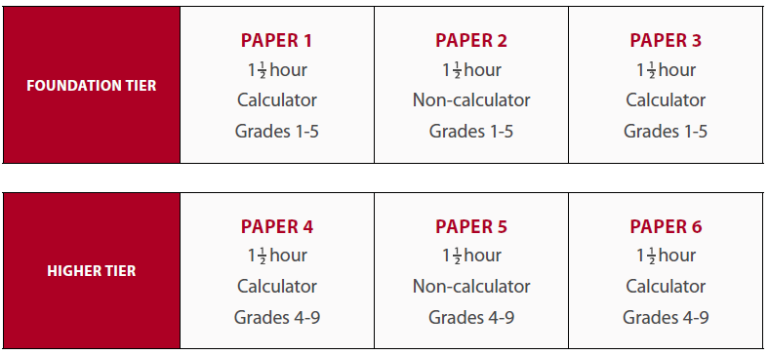
Mathematics
Support at Home:
- notes and worked examples from lessons
- online textbook
- online resources
(MyMaths, MathsWatch and CorbettMaths)
Miss S Forrest
Head of Department
Miss J Walden
Head of KS4 Maths
OCR
Foundation (1-5) &
Higher Tiers (4-9)
Notes:
VK

Slide 13
Science
Support at Home:
Encourage discussions about science in the news
Content heavy – support with fact recall – little and often
Checklists to track content covered
Online tools
Kerboodle – institution code tvd 1. School login. Gives access to online textbook
BBC Bitesize – AQA
YouTube - freesciencelessons
Miss M Price
Head of Department
AQA
Combined Science Trilogy
(worth 2 GCSEs)
Triple Science
(worth 3 GCSEs)
Foundation (1-5) &
Higher Tiers (4-9)
Notes:
VK

Slide 14
Study Support – at home
Consolidation
Tracking
Revision Strategies (5 step plan)
Organisation at home
Resources at home (pp)
Target grades – realistic, aspirational targets
Notes:
EJW

Slide 15
Consolidation
Between lessons - 5-10 minutes
Especially content heavy subjects
Quizzing at home – active learning
Little and often
Encouraging recall
Building long-term memory
Notes:
EJW

Slide 16
Tracking
Checklists
Knowing exam boards/specifications
Progress tracking
Notes:
EJW

Slide 17
5 step plan
IDENTIFY
Identify your strengths and weaknesses for a selected topic area (red/amber/green)
2. RESOLVE
Pick a weak area
Revise it! – How you do this is up to you –
active flashcards, summarising videos, annotating guides, active recall activities etc
3. ASSESS
Quizzes followed by exam questions
4. ANALYSE
Use the markschemes to carefully analyse where marks were lost and gained. Make corrections and learn the corrections
5. REVIEW
Track what you have just covered so you keep a record of your progress
Notes:
EJW

Slide 18
Study Support
Extra to lessons…
Homework (Satchel 1)
Academic mentoring
Intervention and revision sessions
Study Skills Day (Positively You)
Tutor – Revision & Wellbeing Sessions
Pastoral mentoring
Notes:
EJW

Slide 19
Support at home
Satchel 1 app
Encourage hobbies and other interests
Research online + open days
Points calculator (website)
Discussions about subjects they enjoy
Notes:
VK

Slide 20

Attendance in KS4
90% attendance = ½ day missed every week!!
Mon | Tue | Wed |  | Thur | Fri
 |  | ?
Absent half a day every week
Notes:
VK

Slide 21
Let’s looks a little closer…..
1 school year at 90% attendance = 4 whole weeks of lessons MISSED!
38 school weeks
Sept July
 | ?
Absent for 4 weeks
Notes:
VK

Slide 22
We will always support all families having difficulties with attendance. Please communicate as much information as you can to the team so that we can support
90% attendance over 5 years of secondary school….
= ½ a school year missed
Sept July
Y7
Y8
Y9 |  | ½ a year absent from school
Y10
Y11
Notes:
VK

Slide 23
Post-16 / careers development
Piggott Sixth Form Open Evening
Y10 Careers Day (21/11)
Careers Meetings
Tutor Sessions
Assemblies
Y10 Work Shadowing Day
Notes:
EJW

Slide 24
Year 10
Welcome Evening
Thank you for joining us
Notes:
EJW

