Slide 1



Study Health & Social Care in the Piggott Sixth Form
. Health & Social Care . Health & Social Care . Health & Social Care . Health & Social Care . Health & Social Care .
Slide 1 of 32– this presentation lasts 5 minutes

Slide 2
Welcome to the Health & Social Care Department
. Health & Social Care . Health & Social Care . Health & Social Care . Health & Social Care . Health & Social Care .
This is a subject that crosses between two academic areas;
The social sciences (Sociology & Psychology) &
Science (Biology – Anatomy and Physiology
Slide 2 of 32 – this presentation lasts 5 minutes

Slide 3
Who can I talk to about Health & Social Care this evening?
. Health & Social Care . Health & Social Care . Health & Social Care . Health & Social Care . Health & Social Care .
Mrs Karen McNaughton – Subject Lead Teacher for Health & Social Care.
Karen also teaches Sociology & English, she is also Head of Year 12 and a member of the Sixth Form Pastoral Team.
Karen can be found this evening at the A level Sociology stand, covering for a member of staff who is unable to attend due to illness.
Mrs Nicola Jordan-Lewis – Subject Lead Teacher for Applied Science (BTEC)
Nicola teaches Biology, Psychology in addition to Health & Social Care
Nicola can be found next to this laptop at the Applied Science stand.
Slide 3 of 32 – this presentation lasts 5 minutes

Slide 4
Teaching staff have worked in the following care settings
. Health & Social Care . Health & Social Care . Health & Social Care . Health & Social Care . Health & Social Care .
Military hospital
Secure estate – Young Offenders Institute
Residential Care Home for the Elderly
Dental surgery
Therapeutic support – autism
Early years childcare
They can bring the course to life through sharing real life scenarios.
Slide 4 of 32 – this presentation lasts 5 minutes

Slide 5
What will be covered in this presentation?
. Health & Social Care . Health & Social Care . Health & Social Care . Health & Social Care . Health & Social Care .
1. An outline of our course.
2. An indication as to where studying health & social care might lead in the future.
3. Answers to as many frequently asked questions as we could come up with.
Slide 5 of 32 – this presentation lasts 5 minutes

Slide 6
Our course – 6 Units over 2 Years
. Health & Social Care . Health & Social Care . Health & Social Care . Health & Social Care . Health & Social Care .
Year 1
Year 2
Building Positive Relationships in Health & Social Care (coursework unit)
Equality, Diversity & Rights
(examined unit)
Anatomy & Physiology
(examined unit)
Public Health (coursework unit)
Sexual Health & Early Life Development Stages
(coursework unit)
Health, Safety & Security in Health & Social Care
(examined unit)
All units will be explained in more detail later in the presentation.
Slide 6 of 32 – this presentation lasts 5 minutes

Slide 7
Where might this qualification take you?
. Health & Social Care . Health & Social Care . Health & Social Care . Health & Social Care . Health & Social Care .
Previous students have taken the following subjects at university
Previous students have gone on to pursue the following careers
Teaching
Sociology
Psychology
Law
Business Studies
Physiotherapy
Midwifery
Nursing
Nursing & midwifery
Primary school teacher
Social worker
Law
Physiotherapist
Slide 7 of 32– this presentation lasts 5 minutes

Slide 8
Is this subject regarded as academic?
. Health & Social Care . Health & Social Care . Health & Social Care . Health & Social Care . Health & Social Care .
Absolutely!
It is a level 3 qualification and is weighted exactly the same as an A level. It carries just as many UCAS points.
There are 3 examinations in this subject – but unlike A levels you are allowed to take two of them at the end of Year 1. Many people find it helpful to spread exams out, especially students who find being assessed in this way challenging.
Coursework is always completed to the highest standards, we have been praised by the exam board for the quality of our course work.
Students are taught how to write academic essays in preparation for university. Distinction tasks are often set in the form of a traditional essay or report
Slide 8 of 32– this presentation lasts 5 minutes

Slide 9
We get fantastic results!!!
. Health & Social Care . Health & Social Care . Health & Social Care . Health & Social Care . Health & Social Care .
Most of our students achieve distinctions (A grade at A level)
All of our students achieve merit (C grade at A level) or above
This is because assessment is ongoing. It is very hard to fall behind, we catch you before you fall!
Our teachers are very experienced and know how to get the very best from their students.
Slide 9 of 32 – this presentation lasts 5 minutes

Slide 10
What subjects go well with Health & Social Care?
. Health & Social Care . Health & Social Care . Health & Social Care . Health & Social Care . Health & Social Care .
Our students make the decision to take health & social care for many varied reasons, this means that their subject choices are also very varied.
Popular combinations include Health & Social Care with…
Vocational science Psychology
Biology Travel & Tourism
Sociology
English
Business Studies
Slide 10 of 32 – this presentation lasts 5 minutes

Slide 11
Work experience!
At Charvill Piggott
From 2019 all Health & Social Care students
are offered work experience each week as part of
their programme of study.
Many of our practical assignments are based upon
this work experience placement & students
are able to write about first hand experiences,
applying theoretical knowledge to what
happens in real life, with real people. So much more interesting!
Build your CV at the Piggott School while you study.

Slide 12
How can I check I am taking the right subject?
. Health & Social Care . Health & Social Care . Health & Social Care . Health & Social Care . Health & Social Care .
Do some research
Start by using the UCAS website to search for courses or apprenticeships that you might be interested in
Look at the entry requirements
You could also call the university and speak to an admissions tutor
Slide 12 of 32– this presentation lasts 5 minutes

Slide 13
What grades will I need?
. Health & Social Care . Health & Social Care . Health & Social Care . Health & Social Care . Health & Social Care .
You will need to meet our entry requirements for sixth form
English Language & Science is especially important for this course
Slide 13 of 32 – this presentation lasts 5 minutes

Slide 14
Our 6 Units in a little more depth…
. Health & Social Care . Health & Social Care . Health & Social Care . Health & Social Care . Health & Social Care .
Learn more about what you will study should you opt for this subject
Slide 14 of 32– this presentation lasts 5 minutes

Slide 15
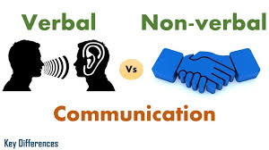




Building Positive Relationships in Health & Social Care

Slide 16
Building Positive Relationships in Health & Social Care
. Health & Social Care . Health & Social Care . Health & Social Care . Health & Social Care . Health & Social Care .
No work in the health and social care sector is completed in isolation. Professional relationships are paramount to the delivery of safe and effective care and support and an understanding of these relationships, and how they are formed, is essential if you are considering pursuing a career in the health and social care sector.
This unit aims to introduce you to the many different relationships that you will encounter within the health and social care sector; whether with colleagues, senior members of staff, other professionals within the sector or individuals who require care and support. By doing this unit you will apply communication and relationship building skills in a practical way, considering how different factors, including context, can impact on the building of positive relationships. You will also be introduced to the concept of the person-centred approach which will help with your relationship building skills.
Slide 16 of 32– this presentation lasts 5 minutes

Slide 17
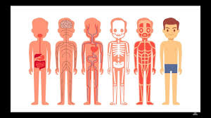
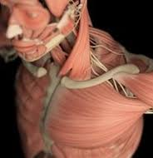

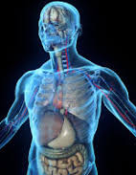
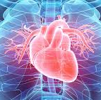
Anatomy & Physiology

Slide 18
Anatomy & Physiology
. Health & Social Care . Health & Social Care . Health & Social Care . Health & Social Care . Health & Social Care .
We eat, we breathe and we control our bodies, as well as responding to the external environment, but why and how? This unit will help you to understand why these essential processes are so important in maintaining life. You will learn not only about the structure and function of some of the cells and tissues involved, but how they form organs and body systems that then have to interact to ensure that the body can provide the conditions necessary for thought, co-ordination, movement and growth.
This unit aims to introduce you to the basic structure and functions of the body systems involved in everyday activities and maintenance of health, including cardiovascular, respiratory and digestive systems. You will also understand the part played by organs such as the pancreas, liver and kidney. You will investigate the systems and organs involved in detecting and responding to change such as the nervous system as well as the eyes and ears.
Unfortunately, things do go wrong and each system has well-known diseases and disorders. Also, as individuals grow older, they are likely to be affected by malfunctions as a result of degeneration. Some of these will simply be inconvenient; others will be life-changers. You will understand the effects on individuals and what has to be done on a daily basis to enable them to lead as full and independent a life as possible.
Slide 18 of 32– this presentation lasts 5 minutes

Slide 19


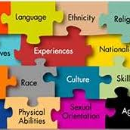



Equality, Diversity & Rights in Health & Social Care

Slide 20
Equality, Diversity & Rights
. Health & Social Care . Health & Social Care . Health & Social Care . Health & Social Care . Health & Social Care .
Everyone is different and everyone has rights. Promoting equality and respecting diversity and rights in health, social care and child care environments is essential in today’s very diverse society. Whatever role you have, or aspire to, in health, social care or child care, an effective practitioner must be able to provide care that meets the needs of individuals and that supports their rights. Many individuals who use health, social care or child care environments can be vulnerable and dependent on others; this means that practitioners’ attitudes, values and prejudices can significantly affect the quality of care, individuals who require care or support experience.
This unit will help you to understand the implications of diversity on practice and also the effects of discriminatory practice on individuals who require care or support. You will also gain an appreciation of how legislation and national initiatives can support and promote anti-discriminatory practice.
Strategies used to promote equality, respect diversity and support individuals’ rights will be examined. You will develop your ability to recognise both good and discriminatory practice in care situations. You will develop your judgement and decision-making skills to choose appropriate responses to care situations and determine a course of action to promote the equality, diversity and rights of individuals in care settings.
Slide 20 of 32 – this presentation lasts 5 minutes

Slide 21

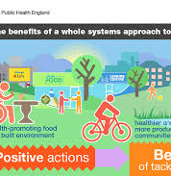




Public Health

Slide 22

Public Health
. Health & Social Care . Health & Social Care . Health & Social Care . Health & Social Care . Health & Social Care .
Health and wellbeing extends further than the individual and the implication of poor health has wider impacts on a community, area and even the country. So how is public health protected? There are many external factors to good health. Clean water and limiting pollution are just two factors that have an influence on our health. An individual cannot control this so who does? Why is public health important and why do you need to know about it?
Slide 22 of 32– this presentation lasts 5 minutes

Slide 23
Public Health
. Health & Social Care . Health & Social Care . Health & Social Care . Health & Social Care . Health & Social Care .
Health and wellbeing extends further than the individual and the implication of poor health has wider impacts on a community, area and even the country. So how is public health protected? There are many external factors to good health. Clean water and limiting pollution are just two factors that have an influence on our health. An individual cannot control this so who does? Why is public health important and why do you need to know about it?
Slide 23 of 32 – this presentation lasts 5 minutes

Slide 24

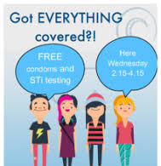

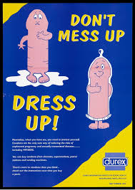

Sexual Health

Slide 25
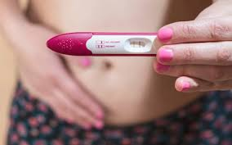

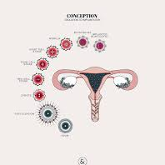
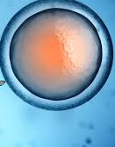
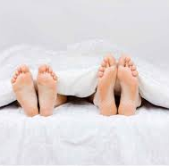
Fertility & Conception

Slide 26
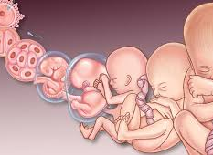
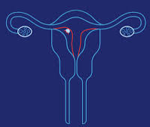
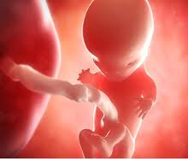

Pregnancy

Slide 27
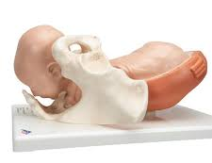
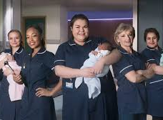
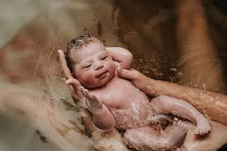
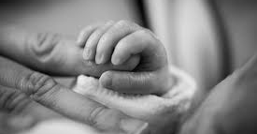
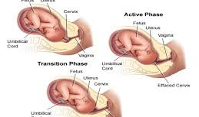
The Birth Process

Slide 28
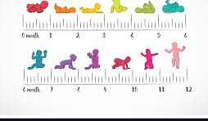

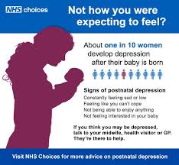
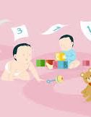
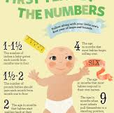
Early Child Development

Slide 29
Sexual Health & Early Life Development Stages
. Health & Social Care . Health & Social Care . Health & Social Care . Health & Social Care . Health & Social Care .
Health and wellbeing is not just relevant when you are an adult; it is just as relevant when you are a child and, as this unit demonstrates, health and wellbeing is of vital importance even before you are born. How can you be sexually healthy? What types of contraception are available? These kinds of questions are essential in contributing to an individual’s overall health and wellbeing.
The health and wellbeing of an individual who is pregnant and the process of birth is impacted by many factors. How do you care for a newborn? What needs does a newborn have and how does this differ to a one-year-old?
All these questions will be considered in this unit. This unit will look at the development from conception to a one-year-old child. On successful completion you will have a sound understanding of the importance of sexual health and contraception. You will understand pre-natal health and the various stages of pregnancy and the factors that could have an impact.
Slide 29 of 32– this presentation lasts 5 minutes

Slide 30



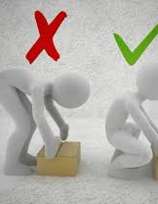


Health, Safety & Security

Slide 31
Health, Safety & Security in Health & Social Care Settings
. Health & Social Care . Health & Social Care . Health & Social Care . Health & Social Care . Health & Social Care .
What does it mean to be ‘safe’? Safety and being safe is a basic human need. Consciously or subconsciously we all take practical steps to stay safe. All individuals have the right to work in a safe environment and individuals who require care or support also have a right to be safe in health and social care contexts. As a result, there are responsibilities that practitioners must actively promote in order to provide and maintain a safe environment for colleagues and the individuals who require care and support.
This unit introduces you to health, safety and security in health and social care. You will acquire the necessary knowledge and skills to equip you in maintaining a safe working environment for yourself, your colleagues and individuals who require care and support. You will learn how legislation, policies and procedures work to reduce risks in health and social care and the consequences of not following them. You will also learn how to respond to different incidents and emergencies with health and social care settings.
Slide 31 of 32 – this presentation lasts 5 minutes

Slide 32
Thank you for watching
. Health & Social Care . Health & Social Care . Health & Social Care . Health & Social Care . Health & Social Care .
Slide 1 of 32 – this presentation lasts 5 minutes

