Slide 1

The Piggott School
On-site Learning – September 2020
Mrs Alexander

Slide 2
Re-opening the Wargrave site
All learners from September 2020
The Secretary of State has said that ‘Education is not optional’ from September
Schools have been directed to fully re-open in September for all students.
We will be responding to guidance from the DfE and Public Health England.
This presentation will explain some ‘systems of control’ and some ‘protective measures’ that aim to :
Minimise risk for us all.
Keep us all safe and well.
Ensure that we can return to school, confident and ready to learn.

Slide 3
Protective measures in school
If you have COVID-19 symptoms, you must stay at home.
Clean hands thoroughly and more often than usual.
‘Catch it, bin it, kill it’ – use tissues and bins.
Weather permitting – all doors and windows will be open for air flow
Enhanced cleaning arrangements – in all areas of the school.
Social distancing – minimise contact when moving around the site.
The use of PPE where applicable
Grouping young people together – ‘Super bubbles’ of a year group
Classroom layouts – where possible, forward facing desks.
Active engagement with NHS Test and Trace

Slide 4
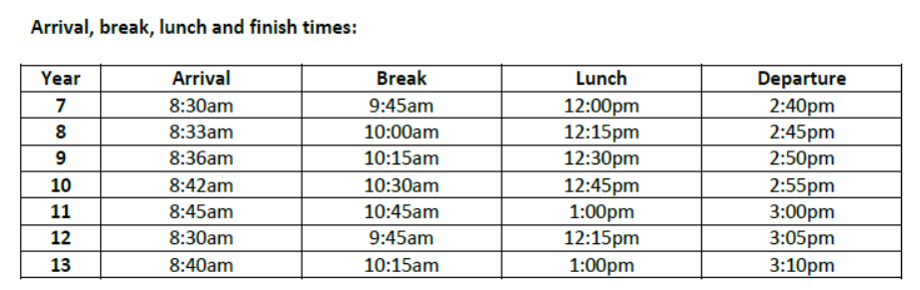
The School Day
New timings to the school day – there will be lots of signs to help you remember them.
Staggered arrival times, staggered break, staggered lunch and staggered departure times

Slide 5
The School Day
Three longer lessons per day – minimise movement across the site
Tutor time
Lesson 1 – including a staggered break time (only your year group)
Lesson 2 – including a staggered lunch time (only your year group)
Lesson 3
You will have all of your lessons on your normal timetable but over a four week cycle, not a two week cycle.
Week A Week 1a - Lesson 1, lesson 2 and lesson 5
Week 2a - Lesson 1, lesson 2 and lesson 5
Week B Week 1b - Lesson 3, lesson 4 and lesson 5
Week 2b - Lesson 3, lesson 4 and lesson 5

Slide 6
Equipment & Facilities
You must bring your own equipment for learning
Some subjects may require some specialist equipment – to be confirmed
Uniform – Full uniform apart from your school tie
PE – if you have PE, you can come in kit for the whole school day.
You may want to bring a spare change of clothes.
The canteen – food will be available.
Social distancing and safety measures will be in place.
You can bring your own packed lunch.
Toilet facilities – checked regularly to ensure soap is available for hand washing.
Extra wash basins will be installed across the site.

Slide 7
Travelling to & moving around the site
All students encouraged to travel to school by foot or bike, where possible.
Students travelling by public transport should wear masks and socially distance
Wash your hands on arrival to school.
Students should arrive and depart as close as possible to their designated times.
On arrival, students should immediately go to their tutor base.
Use external doors to classrooms where possible.
Follow all signage - showing where to line up and one way systems.
Do not socialise or mix with students from other year groups – socially distance
Normal behaviour expectations apply – follow all instructions promptly.
Risky or unsafe behaviour will be challenged and sanctioned.

Slide 8
Learning in the classroom
Where possible, classroom layouts will be modified. Forward facing desks.
In specialist rooms, this may not be possible.
Seating plans in place – students should stay seated at all times.
The teacher will remain at the front and socially distance, where possible.
Group work is not permitted – alternative learning activities will be considered.
Resources such as worksheets, books and learning materials cannot be shared.
Staff will maximise the use of technology to support your learning and progress.
Marking – staff will not be able to collate and physically mark work. They will consider alternative feedback options such as online platforms, peer and self assessment and whole class feedback.
Staff will continue to plan for and provide specific support for students with additional learning needs.

Slide 9

It will be different but … we will manage it together !

